Slide 1
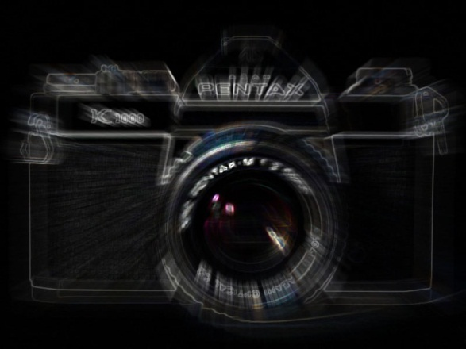
Photographic Composition
Getting Viewers to see what you want them to see!

Slide 2
Compositional Elements
Stop Action
Selective Focus
Rule of Thirds
Framing
Leading Lines
Texture
Perspective
Lighting
Balance
Informal
Formal
Color
Portraiture

Slide 3
Compositional Elements
NOTE:
These elements rarely appear in an image by themselves. There are usually multiple elements that make up the composition of an image.

Slide 4
Photographic Composition
Leading Lines
Getting Viewers to see what you want them to see!

Slide 5
Leading Lines
Leading lines are lines within an image that lead the eye to another point in the image, or
occasionally,
out of the
image.

Slide 6
Leading Lines
Anything with a definite line can be a leading line. Fences, bridges, even a shoreline can lead the eye.

Slide 7
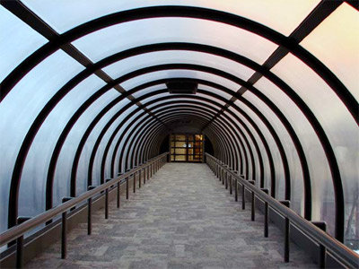
Leading Lines
Lead the viewers eyes to the Subject

Slide 8
Leading Lines
If you can pair leading lines with a subject that is placed according to the rule of thirds your image should be very strong.

Slide 9
Leading Lines
Lead the viewers eye into the Frame

