Slide 1
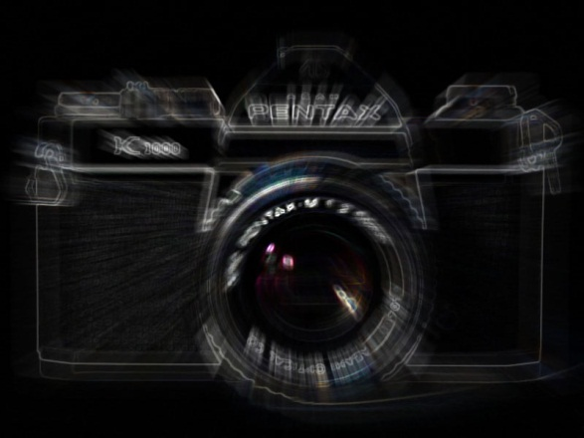
Photographic Composition
Getting Viewers to see what you want them to see!

Slide 2
Compositional Elements
Stop Action
Selective Focus
Rule of Thirds
Framing
Leading Lines
Texture
Perspective
Lighting
Balance
Informal
Formal
Color
Portraiture

Slide 3
Compositional Elements
NOTE:
These elements rarely appear in an image by themselves. There are usually multiple elements that make up the composition of an image.

Slide 4
Photographic Composition
Texture
Getting Viewers to see what you want them to see!

Slide 5
Texture
The visual and especially tactile (perceptible to the touch; tangible.) quality of a surface.

Slide 6
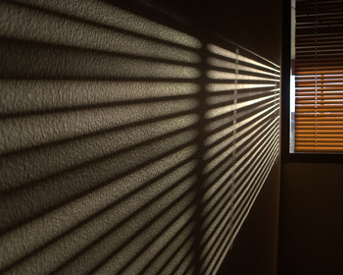
Texture
Intimately linked to the compositional element of Lighting.

Slide 7
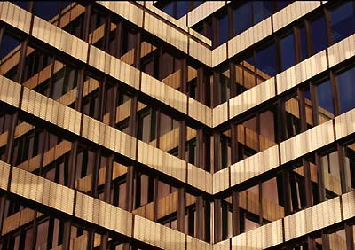
Texture
Most repeating patterns have texture.

Slide 8
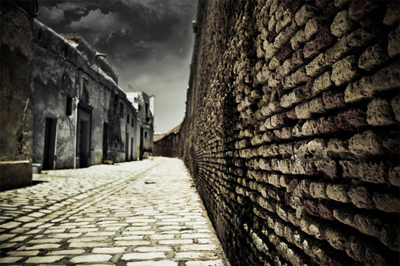
Texture

Slide 9
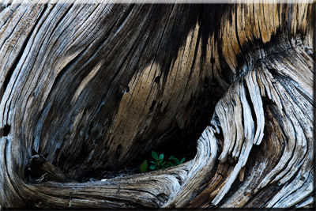
Texture

